Slide 1


Understanding Communication and Rapport

Slide 2

Empowering Mankind
MySkill - Empowering womanhood, is program with a vision to give a platform to all the women for diversifying their existing skills to meet today's challenges. MySkill aims at building actual competencies to achieve their highest desired level of independence and inclusion in their communities.
MySkill has partnered with institutes who have a proven track record of training and empowering women through various educational and experiential learning in the past.
MySkill offers a platform for all aspiring women who want to have a greater expansion in professional and personal growth which in turn contribute to structural transformation and economic growth by enhancing employability.

Slide 3
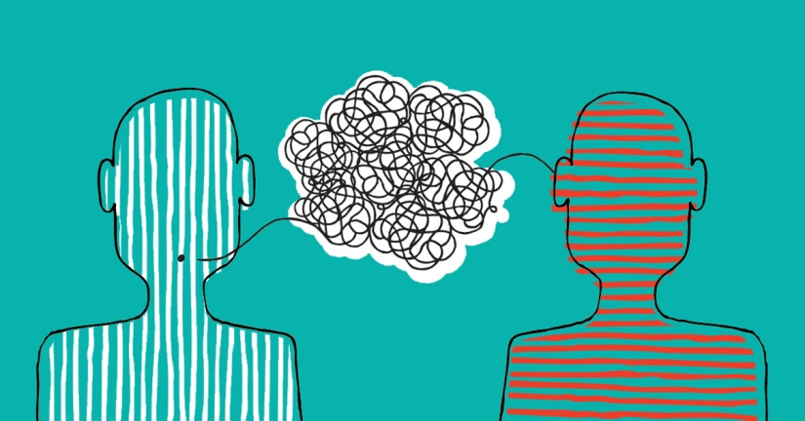
Agenda
Understanding the Communication Model
Tips for Effective Communication
Verbal vs. Nonverbal Communication
Active Listening Skills
Practicing Communication Skills
Importance of Rapport in Communication
Techniques for Building Rapport
Rapport Building Exercise
Conclusion

Slide 4


Understanding the Communication Model
Plus tip:
Communication
Consider including examples or scenarios that illustrate each component of the communication model.
Sender
Message
Receiver
The sender is the person who initiates the message, responsible for encoding it clearly and effectively.
The message consists of the information, thoughts, or feelings conveyed from the sender to the receiver. It can be verbal (spoken or written) or nonverbal (gestures, body language).
The receiver is the individual who receives and decodes the message. Effective communication occurs when the receiver understands the message as intended by the sender.

Slide 5
Tips for Effective Communication
Plus tip:
Communication
Consider tailoring these tips to specific situations or audiences you frequently communicate with. This will help make your communication more effective and relevant.
Ensure clarity and conciseness in your messages.
Be aware of potential barriers (e.g., noise, misunderstandings) that can disrupt communication.
Provide feedback to confirm understanding.

Slide 6
Verbal vs. Nonverbal Communication
Communication Techniques
Verbal Communication
Nonverbal Communication
Definition: The use of spoken or written language to share information.
Techniques: Use clear, concise language.
Adjust your tone, volume, and pace according to the context.
Tailor your vocabulary to the audience’s level of understanding.
Definition: The transmission of messages without words, through body language, facial expressions, gestures, eye contact, and posture.
Key Aspects: Body language can convey confidence, openness, or defensiveness.
Facial expressions often reflect emotions and attitudes.
Eye contact indicates engagement and interest; too little can signal discomfort.
Gestures can enhance or contradict verbal messages.

Slide 7

Active Listening Skills
Plus tip:
Techniques
Consider incorporating examples of each technique in your presentation to illustrate their effectiveness in real-life scenarios.
Pay Attention
Focus fully on the speaker, avoiding distractions. Use nonverbal cues (nodding, eye contact) to show you’re engaged.
Show That You’re Listening
Use affirmative gestures or phrases (e.g., “I see,” “Go on”) to indicate your engagement.
Provide Feedback
Paraphrase or summarize what the speaker has said to confirm understanding (e.g., “So what you’re saying is…”).
Defer Judgment
Avoid interrupting or forming opinions while the other person is speaking. Let them finish their thoughts.

Slide 8


Practicing Communication Skills
Plus tip:
Skills Development
Consider incorporating real-life scenarios in role playing to make the practice more relevant. Use group discussions to explore diverse viewpoints and improve adaptability in communication.
Feedback Sessions
Role Playing
Group Discussions
Seek feedback from trusted colleagues or friends on your communication style and areas for improvement. Constructive criticism is essential for identifying strengths and weaknesses in communication.
Engage in role playing exercises with peers to practice verbal and nonverbal communication scenarios. This method allows individuals to experience different perspectives and enhance their expressive skills.
Participate in group discussions to enhance both speaking and listening skills. These interactions foster an environment where participants can practice articulating their thoughts while responding to others.

Slide 9
Importance of Rapport in Communication
Plus tip:
Rapport
Consider adding examples of how rapport can be built in various settings, such as in the workplace or in personal relationships.
Trust and Comfort
Enhanced Communication
Establishing rapport helps to build trust, making others feel more comfortable sharing thoughts and feelings.
When rapport is present, communication flows more smoothly, leading to better understanding and collaboration.
Conflict Resolution
Increased Engagement
Strong rapport can facilitate conflict resolution by promoting empathy and mutual respect.
People are more likely to engage and participate in discussions when they feel a connection with the other person.

Slide 10
Techniques for Building Rapport
Plus tip:
Rapport
Consider incorporating personal examples or scenarios to illustrate how these techniques can be applied in real-life situations.
Matching and Mirroring
Matching and mirroring involve subtly mimicking the body language, speech patterns, and tone of the person you’re communicating with. Matching refers to adopting similar gestures, posture, and facial expressions, while mirroring is a more direct imitation of another person's behavior.
Active Listening
Show genuine interest in what the other person is saying. Use nods, affirmations, and questions to demonstrate engagement. Phrases like 'I understand how you feel' help build emotional connection.
Empathy
Express understanding and validate the other person’s feelings. Empathy fosters a deeper connection and enhances mutual respect in communication.
Finding Shared Interests
Identify common ground or interests to create a sense of connection. This could be hobbies, experiences, or goals that resonate with both individuals.

Slide 11

Rapport Building Exercise
Plus tip:
Activities
Consider adjusting the scenarios used in the exercise to fit different contexts, such as professional settings or social gatherings.
Observation
Matching and Mirroring
Feedback
Reflection
Take turns observing each other. One partner speaks for a few minutes about a topic (e.g., a recent experience). The listener should focus on body language and tone.
Switch roles. The listener becomes the speaker and matches the body language and tone of their partner while discussing a new topic. Focus on natural expressions.
After practicing, provide feedback on how effectively they matched body language and tone and how it felt to connect through these techniques.
Discuss how these techniques apply in real life. Reflect on instances where building rapport could enhance communication in various contexts.
Observational notes
Understanding of nonverbal cues
Demonstrated matching and mirroring skills
Enhanced awareness of body language
Constructive feedback notes
Insights on rapport-building effectiveness
Reflection notes
Practical applications for future interactions

Slide 12

Conclusion
Plus tip:
Summary
Consider adding personal experiences or examples to illustrate the importance of these communication techniques in your own life.
Effective communication skills are built upon a solid understanding of the communication model, which includes the roles of the sender, message, and receiver. Key aspects of effective communication include clarity, awareness of barriers, and feedback. Active listening is vital, encompassing techniques such as paying attention, showing engagement, providing feedback, deferring judgment, and responding appropriately. Building rapport is essential in fostering trust and enhancing communication, with techniques like matching and mirroring, active listening, empathy, and identifying shared interests. Continuous practice of these skills is crucial for improvement and developing meaningful interactions in personal and professional contexts.

Slide 13

MySkool is an inspiration for schools, teachers, parents and students to excel in life. It is a message that ‘good is always appreciated.’ It is a push towards self motivation, an opportunity to see how others are growing and a chance to appreciate fellow human beings.

